Slide 1
Nature of time series data

Slide 2
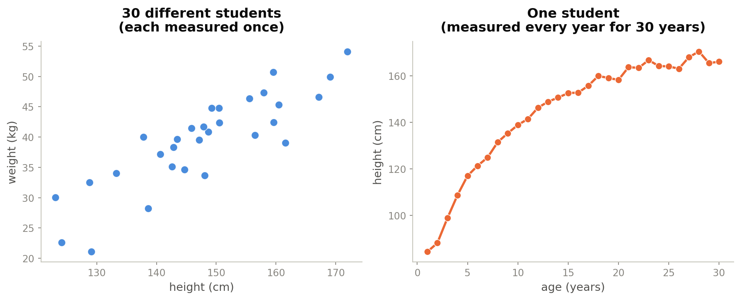
Example:
Regression data: many different individuals, each measured once.
Time-series data: one individual, measured again and again.
Same number of data points but a completely different kind of information.
02

Slide 3
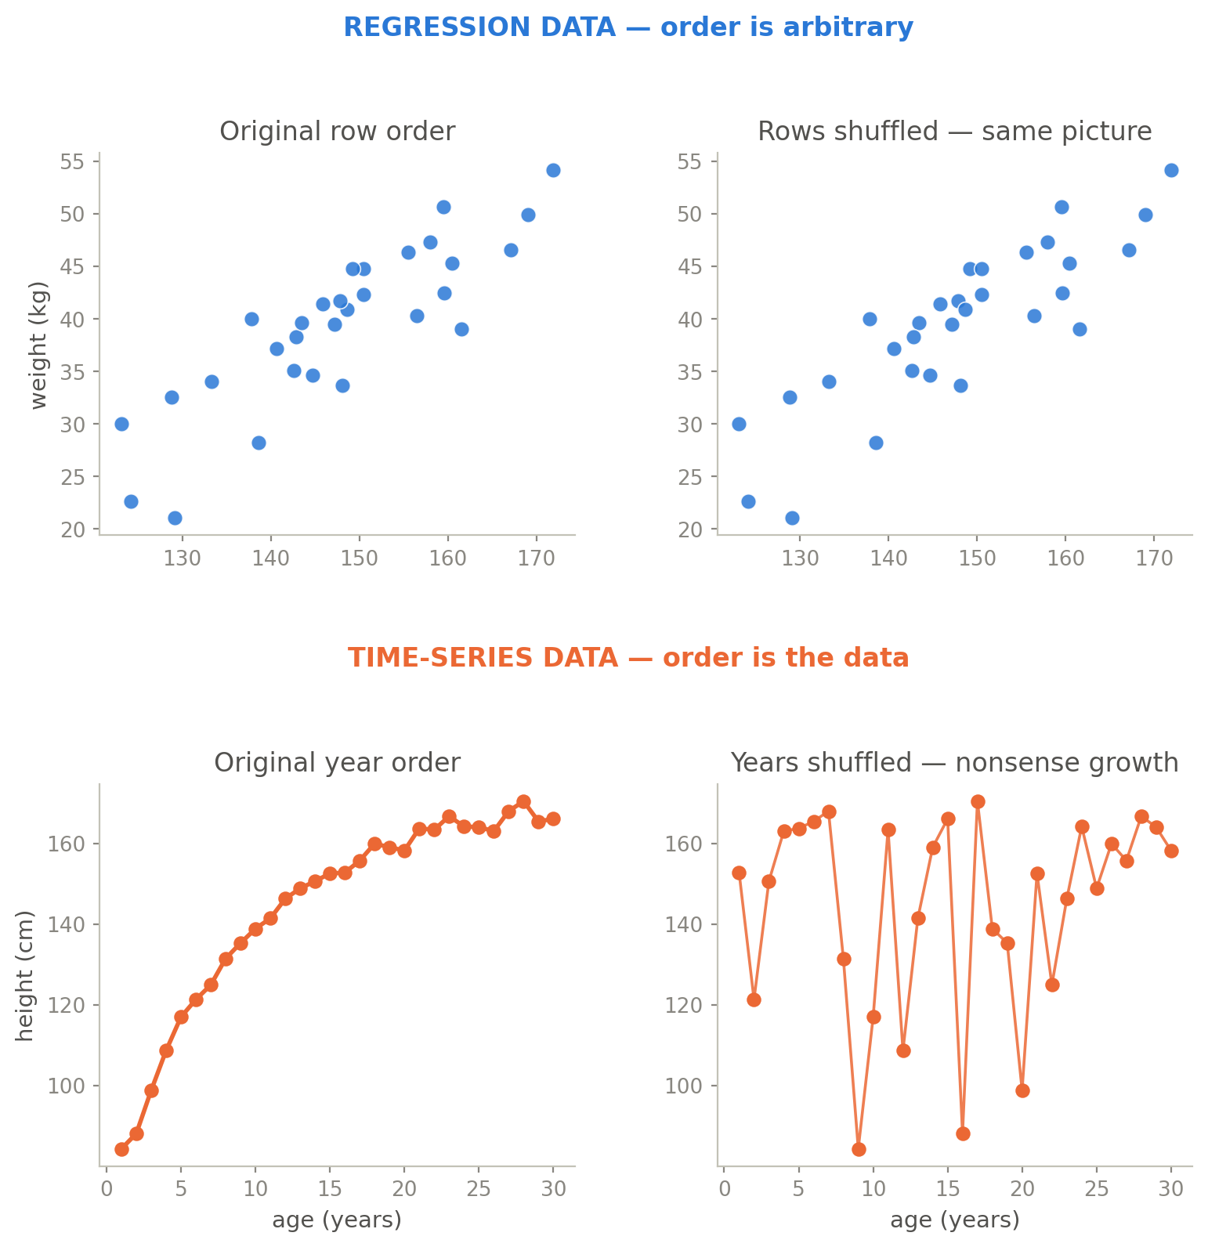
Order Matters
In a regression, it doesn't matter which one you list first.
In a time series, shuffling data wrecks the story.
The order IS the data in a time series.
03

Slide 4
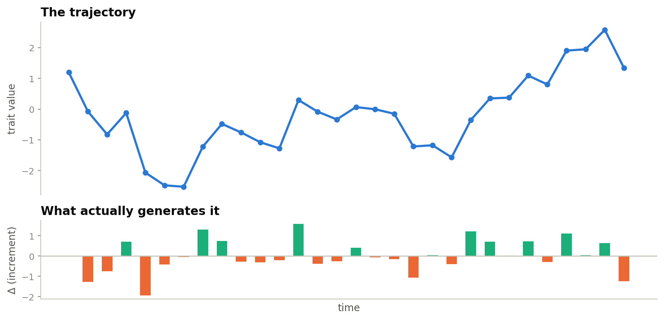
Order Matters
Consecutive samples are dependent: the value at t is the value at t−1 plus whatever happened in between.
50 dependent samples don't carry 50 samples' worth of information (effective sample size shrinks).
Every standard error computed under independence is too small (and every p-value too generous.)
03

Slide 5
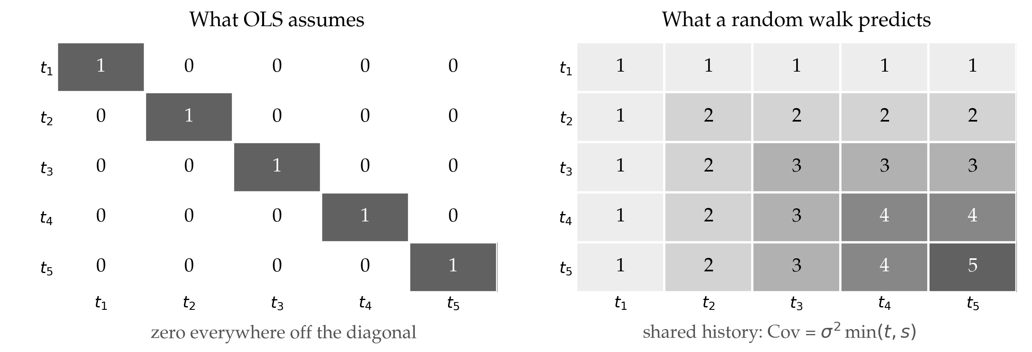
What ordinary regression quietly assumes
A normal regression assumes the errors are independent: Cov(εᵢ, εⱼ) = 0 for every pair of observations. That is what makes each new point count as a whole new point.
In a fossil time series that assumption is simply false: the trait mean at time t already contains the trait mean at t−1.
Notes:
Connects back to the "order matters" slides. The variance–covariance matrix is the formal statement of the independence assumption: OLS puts σ² on the diagonal and zero everywhere else. A random walk fills the off-diagonal in, because two samples share all the evolutionary history up to the earlier of the two — hence Cov = σ² min(t,s). Point out the numbers along the right-hand diagonal: the variance itself grows with time, so late samples are more spread out than early ones. Ignoring all of this is exactly what shrinks the standard errors and inflates significance.

Slide 6
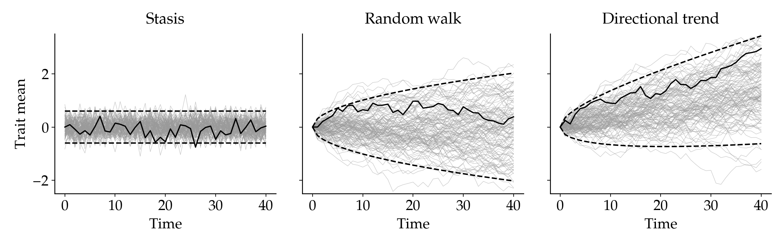
A model of evolution is a model of covariance
250 simulated lineages per mode, with the expected ±2 SD band
Stasis: Cov(t, s) = 0 — the band never widens
Random walk: Cov(t, s) = σ² · min(t, s) — the band widens as √time
Directional trend: the same covariance, but the expected value moves
Choosing a mode of evolution means choosing a covariance structure.
Notes:
The previous slide showed one realisation of each mode; this one shows what the model actually says — the whole distribution of lineages it can produce. The dashed band is the model's prediction about covariance made visible. Stasis is the exception: it predicts zero covariance, so a stasis time series really is a set of independent draws — which is precisely why all four adePEM tests are white-noise tests, and why random-walk and trend data are detrended first. Detrending removes the covariance the model predicts; if the model is right, what is left should be independent. Note that paleoTS also adds the uncertainty in each sample mean to the diagonal of the matrix.

